Slide 1
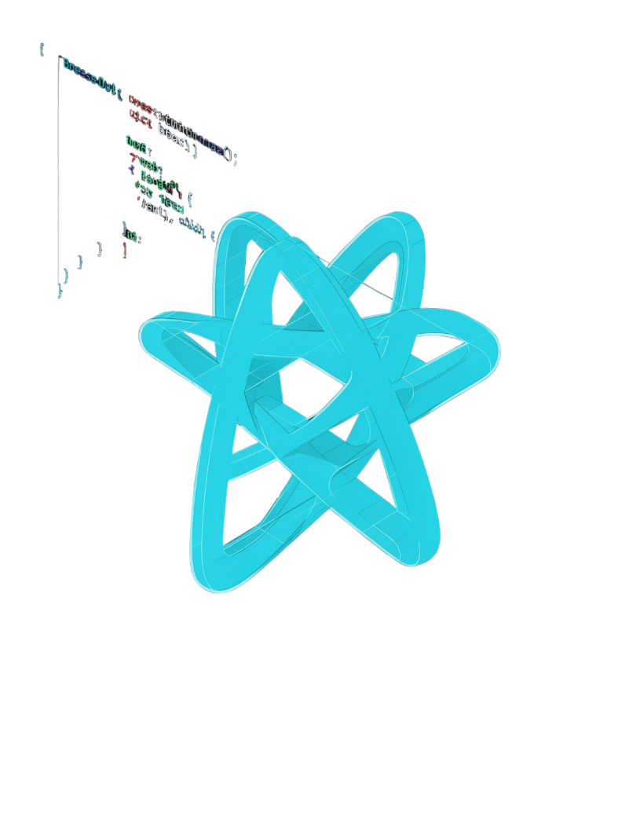
React.js – MERN Stack Teaching Guide
Master React fundamentals and build dynamic user interfaces

Slide 2
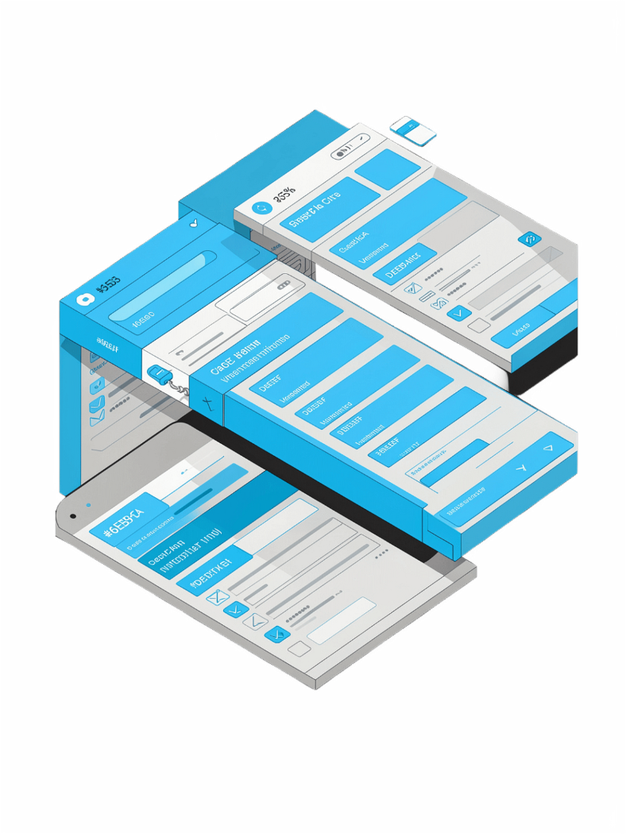
What is React.js?
UI Library
Builds interactive user interfaces with JavaScript
Reusable Components
Divides UI into small, composable pieces
Reactive Updates
Screen changes automatically when state or data changes
MERN Frontend
The R in the MERN stack

Slide 3
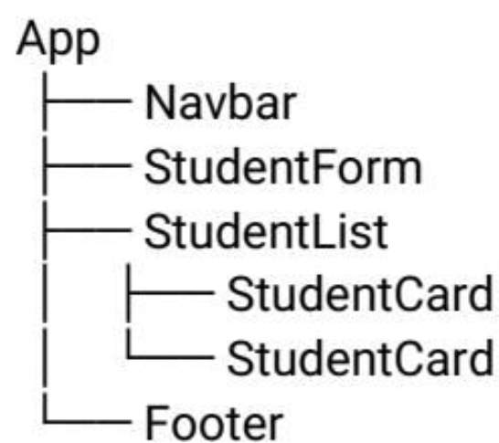
React Component Structure
Think of an application as a tree of components:
App (root)
├── Navbar
├── StudentForm
├── StudentList
│ ├── StudentCard
│ └── StudentCard
└── Footer
Every UI element is a node in the component tree — composable and reusable.

Slide 4
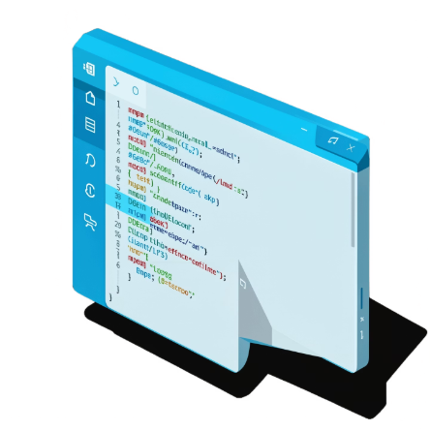
React Setup with Vite
Create & Run
01
npm create vite@latest student-app
02
cd student-app
03
npm install
Project Structure
04
main.jsx – Entry point, mounts the app
App.jsx – Main application component
package.json – Scripts & dependencies
node_modules/ – Installed packages
npm run dev

Slide 5
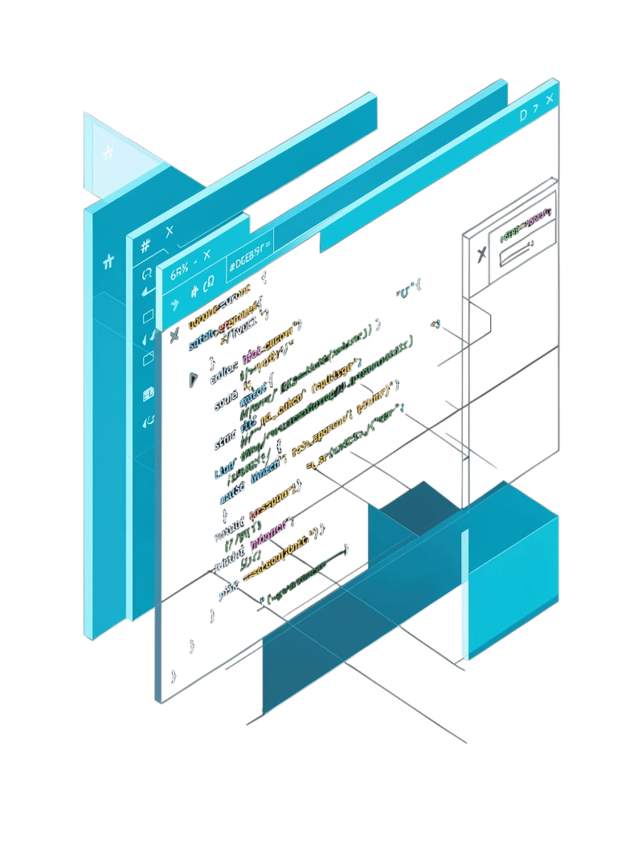


JSX – JavaScript XML
{} Expressions
JavaScript expressions go inside curly braces
className
Use className instead of class
Closed Tags
All JSX elements must be properly closed
One Root Element
Return one parent element or a Fragment <>...</>

Slide 6




Handling Events in React
onClick
Handle button clicks
onChange
Handle input field changes — event.target.value
onSubmit
Handle form submissions — use preventDefault()

Slide 7



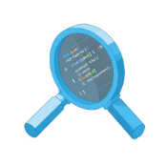
Components – Building Blocks of React
Capital Names
Reusability
Single Responsibility
Maintainability
Component names must start with a capital letter
One component can be used many times across the app
A good component has one clear, focused purpose
Easier to understand, test, and maintain

Slide 8

Props – Passing Data to Components
How Props Work
Props are inputs passed from a parent to a child component, allowing the same component to display different data.
Parent → Child
Any Type
Read-Only
One-directional data flow
Strings, numbers, arrays, objects, functions, JSX
Never modify props inside the child component

Slide 9
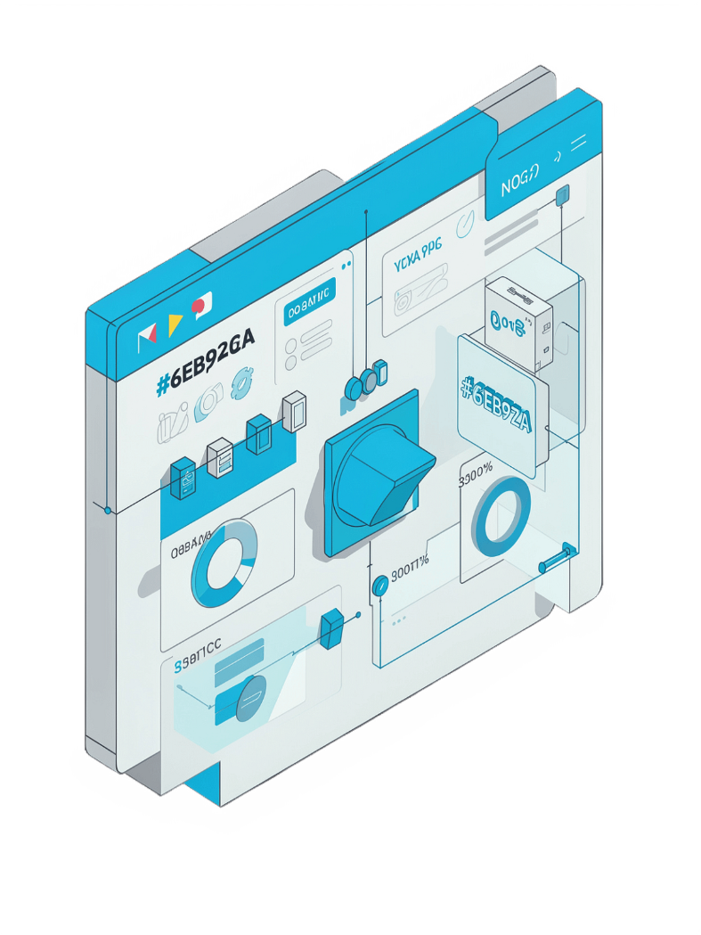

State and useState Hook
count
setCount
Current state value
Function used to update state
0
Initial value passed to useState
Never mutate state directly — always use the setter function. React automatically re-renders the component when state changes.

Slide 10
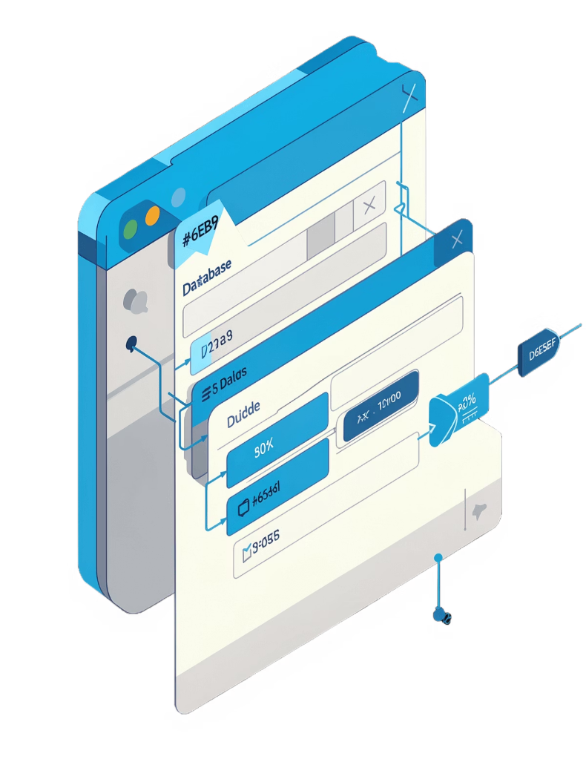



Forms and Controlled Components
State → Input
Input value is driven by React state
onChange → State
User typing updates state in real time
onSubmit → API
Reads current state and sends data to the backend
HTML input values are strings — convert types when necessary before sending to the API.

Slide 11
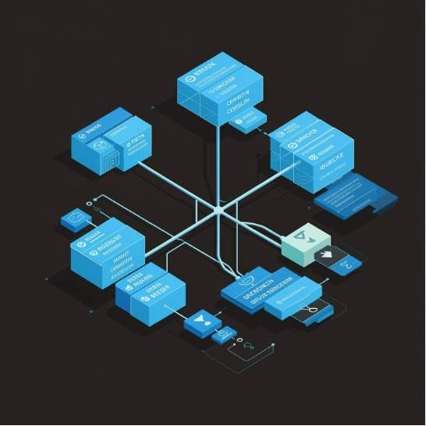
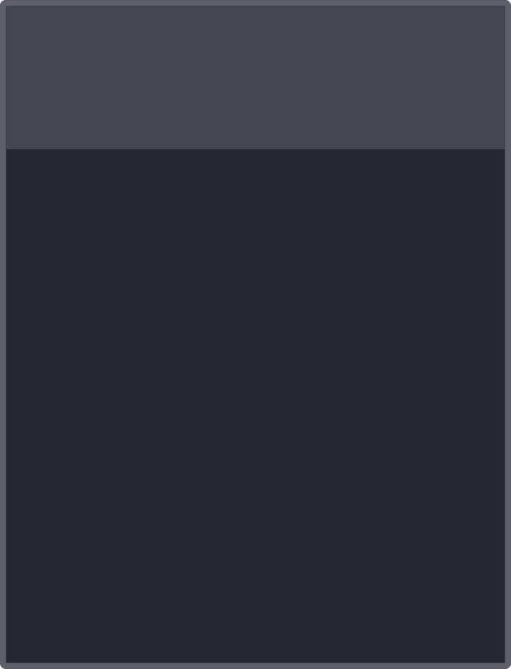



Conditional Rendering
Show the Right UI at the Right Time
&& Logical AND
Ternary ? :
Loading State
Show one of two alternatives based on condition
Display "Loading..." while fetching data from API
Show something only when a condition is true

Slide 12

Rendering Lists with map() and Keys
When displaying dynamic collections of data in React, the map() array method is crucial for transforming data into renderable JSX. For proper functionality and performance, every item in a rendered list must be assigned a unique key prop.
1
map() for Transformation
2
Unique key Prop
Iterates over an array, returning a new array of JSX elements to be rendered by React.
A special string attribute that React uses to identify each list item's stable identity across renders.
3
Optimized Re-renders
Keys enable React to efficiently track which items have changed, been added, or removed, enhancing performance and preventing bugs, especially when lists are reordered or filtered.
Always use a stable, unique ID (e.g., from a database) for keys. Using an item's index as a key is generally discouraged if the list items can change order, be added, or removed.

Slide 13




useEffect Hook – Side Effects and API Calls
The useEffect Hook lets you synchronize a component with an external system after rendering, managing "side effects" like data fetching, subscriptions, or manual DOM manipulation.
After Render
Executes side effects after the component has rendered, preventing UI blocking.
Common Uses
Ideal for data fetching, setting up subscriptions, or directly interacting with the DOM.
Dependency Array
Controls when the effect re-runs. An empty array [] runs once on mount.
Omitting the dependency array causes the effect to run after every render, which can lead to performance issues or infinite loops if not handled carefully.

Slide 14
Key Takeaways for Students
Mastering React involves understanding its core principles and how they work together to create dynamic user interfaces.
1
React and Components
Grasp what React is and why building with reusable components is fundamental to modern UI development.
2
JSX Syntax
Learn to write JavaScript XML (JSX) to seamlessly combine HTML-like markup with JavaScript logic.
3
Props for Communication
Understand how to pass data from parent to child components using props to make them dynamic and configurable.
4
State and useState
Manage dynamic data within components using the useState Hook to enable interactive UIs.
5
Event Handlers
Implement event handlers (like onClick, onChange) to respond to user interactions effectively.
6
Controlled Components
Handle form inputs by connecting them to React state, ensuring predictable data flow and validation.
7
Conditional Rendering
Display different UI elements based on certain conditions, making your applications responsive and adaptable.
8
Lists with map() and Keys
Efficiently render dynamic lists of data using the map() method, remembering the importance of unique key props.
9
useEffect for Side Effects
Utilize the useEffect Hook for managing side effects, such as data fetching, subscriptions, and DOM manipulation.
10
Component Communication
Explore patterns for how components interact, including lifting state up and passing functions as props.
The Most Important Chain
Understanding the complete data flow is key:
Component → State → Event → API → Response → State Update → UI Re-render

Slide 15





Advanced Topics to Explore Later
With only 10 hours allocated for the entire MERN stack, we've focused on core React fundamentals. These advanced topics are your next steps for mastering React development and building more robust applications.
State Management
Redux, Redux Toolkit, React Query
Advanced Hooks
useReducer, useMemo, useCallback, useRef
Advanced Features
Error Boundaries, Suspense, Server Components
Performance & Testing
Optimization techniques, Testing strategies
Custom Hooks
Creating reusable logic

Slide 16
The Complete MERN Flow
Understanding the full lifecycle of a request in a MERN stack application, from user interaction to data display.
01
02
03
React Renders
User Interaction
Frontend Request
The UI initially renders or updates based on state/props changes.
User actions (e.g., button click, form submit) trigger events in the React component.
React sends an HTTP API request (e.g., using Fetch or Axios) to the Express backend.
04
05
06
Backend Routing
Database Query
Database Response
The Express server receives the request and routes it to the appropriate Node.js handler.
Node.js, often using Mongoose, queries the MongoDB database to retrieve or store data.
MongoDB executes the query and returns the requested data to the Node.js application.
07
08
09
Backend Response
State Update
UI Re-render
Express processes the data, formats it as JSON, and sends it back as a response to React.
The React component receives the JSON response and updates its internal state with the new data.
React automatically re-renders the component to display the updated information to the user.

Slide 17

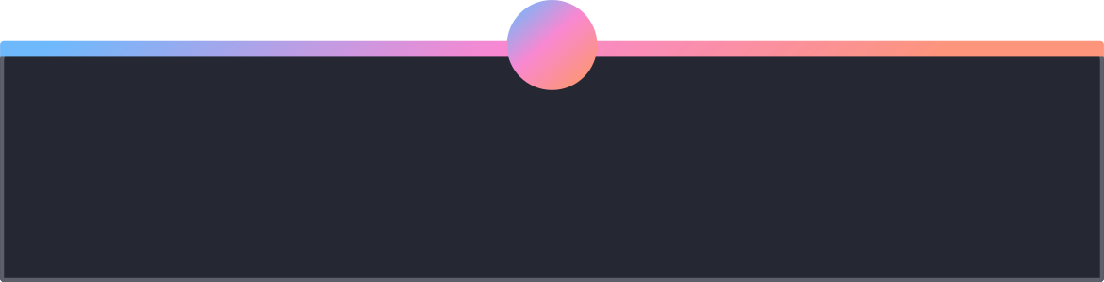



Component Communication
Understanding how components communicate is fundamental to building robust React applications. Data flows predictably, and interactions are managed through well-defined patterns.
Parent
Props
Holds state and passes props down to child.
Data flows down from parent into child components.
Child
Callbacks
Receives props and triggers callbacks upward.
Events bubble up to update parent state.
Data Down (Props)
Events Up (Callbacks)
Shared State
Parents pass data to children using props. This is a one-way flow, making data predictable and easy to trace.
Children communicate with parents by calling functions (callbacks) passed down as props, notifying the parent of events or state changes.
When multiple components need to share the same state, lift that state up to their closest common parent component.
The "data down, events up" pattern ensures a clear and understandable data flow, reducing potential bugs and simplifying debugging.

Slide 18


React Router – Navigation
React Router provides declarative routing, allowing your React application to display different UI components based on the browser's URL, without requiring a full page reload. It's essential for building dynamic single-page applications.
Dynamic Views
Displays different components based on the current URL path.
SPA Navigation
Enables seamless single-page application (SPA) user experiences.
Easy Setup
Install with npm install react-router-dom.
Core Routes
Use for main screens like /home, /students, or /add-student.

Slide 19




Handling API Request States
When building dynamic applications, fetching data from APIs is common. These requests are asynchronous, meaning they take time and can result in various outcomes. Effectively handling these states ensures a robust and user-friendly experience.
Loading State
Error State
Display a "Loading..." message or spinner while data is being fetched, preventing UI blocking and informing the user.
Show clear, actionable error messages if the API request fails (e.g., network error, server issue), guiding the user on next steps.
Empty State
Success State
Inform the user when an API request succeeds but returns no data (e.g., "No results found"), offering alternatives or suggestions.
Render the fetched data once the API request is successful, presenting the content as intended.
Teaching students to consider the full lifecycle of an API request – from initiation to all possible outcomes – is crucial for building resilient React applications.

Slide 20




API Calls from React
React applications typically communicate with a backend server (like Node.js with Express) through HTTP requests to fetch, create, update, and delete data. This interaction occurs via a well-defined Application Programming Interface (API).
GET
POST
Retrieves data from the server. Used for fetching all resources or a specific resource by ID.
Sends new data to create a resource on the server. Commonly used for form submissions.
PUT / PATCH
DELETE
Updates an existing resource on the server. PUT replaces the entire resource, PATCH applies partial modifications.
Removes a specific resource from the server. Identified by its unique ID.
React (frontend) should never connect directly to a database like MongoDB. All database operations must be handled by your backend server for security and architectural integrity.

Slide 21
Thank You!
You're now ready to build with React
Learn Once, Write Anywhere

